Slide 1
Supermarket sales

Slide 2
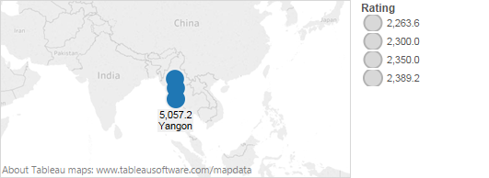
city sales

Slide 3
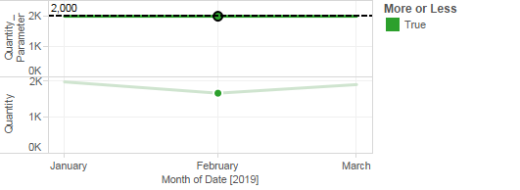
monthly quanity sold

Slide 4
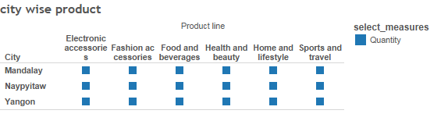
city wise product

Slide 5
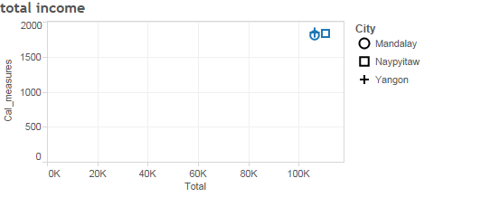
total income

Slide 6
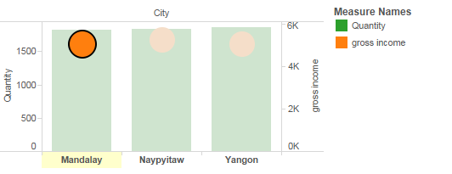
city wise income

Slide 7
Video link
https://drive.google.com/file/d/18XgUEGCNuXEeo2IGoReERzAXsLr_HU4r/view?usp=sharing

Slide 8
Thankyou

